Slide 1

337
Angular
Notes:
https://angular2-intro.firebaseapp.com/#/29
http://angularjs.blogspot.nl/2015/08/angular-1-and-angular-2-coexistence.html
http://larseidnes.com/2014/11/05/angularjs-the-bad-parts/
Example GITHUB → https://github.com/r-park/book-angular2-firebase
http://tryangular2.github.io/#/section-9/page-37

Slide 2
Agenda – 3 dagen
dag 1
Angular inleiding + CLI + Project Structure
Directives
Databinding
DI
Service and http, Observables
Components
dag 2
Routing
Exercise
Create an App with NativeScript + Angular
dag 3
Forms

Slide 3

Over jullie…

Slide 4
Voorkennis webdevelopment, (mobile/web-) apps?
Kennis AngularJS 1.x? Voorkennis andere (web)talen? Verwachtingen van de cursus?
Concrete projecten?

Slide 5
Globale werkwijze
Ik
Jullie
…

Slide 6


Slide 7
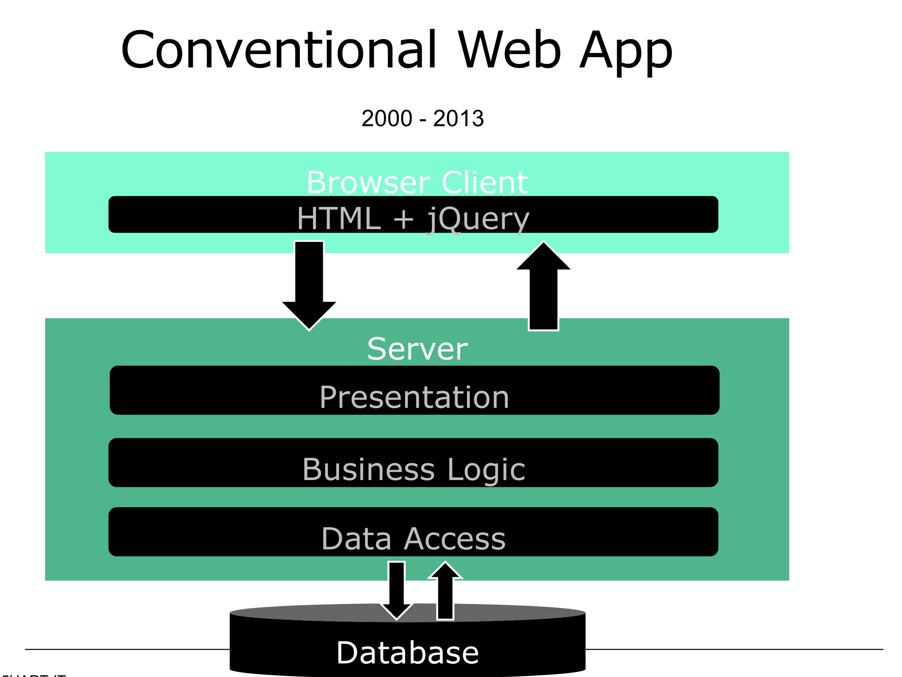

Slide 8
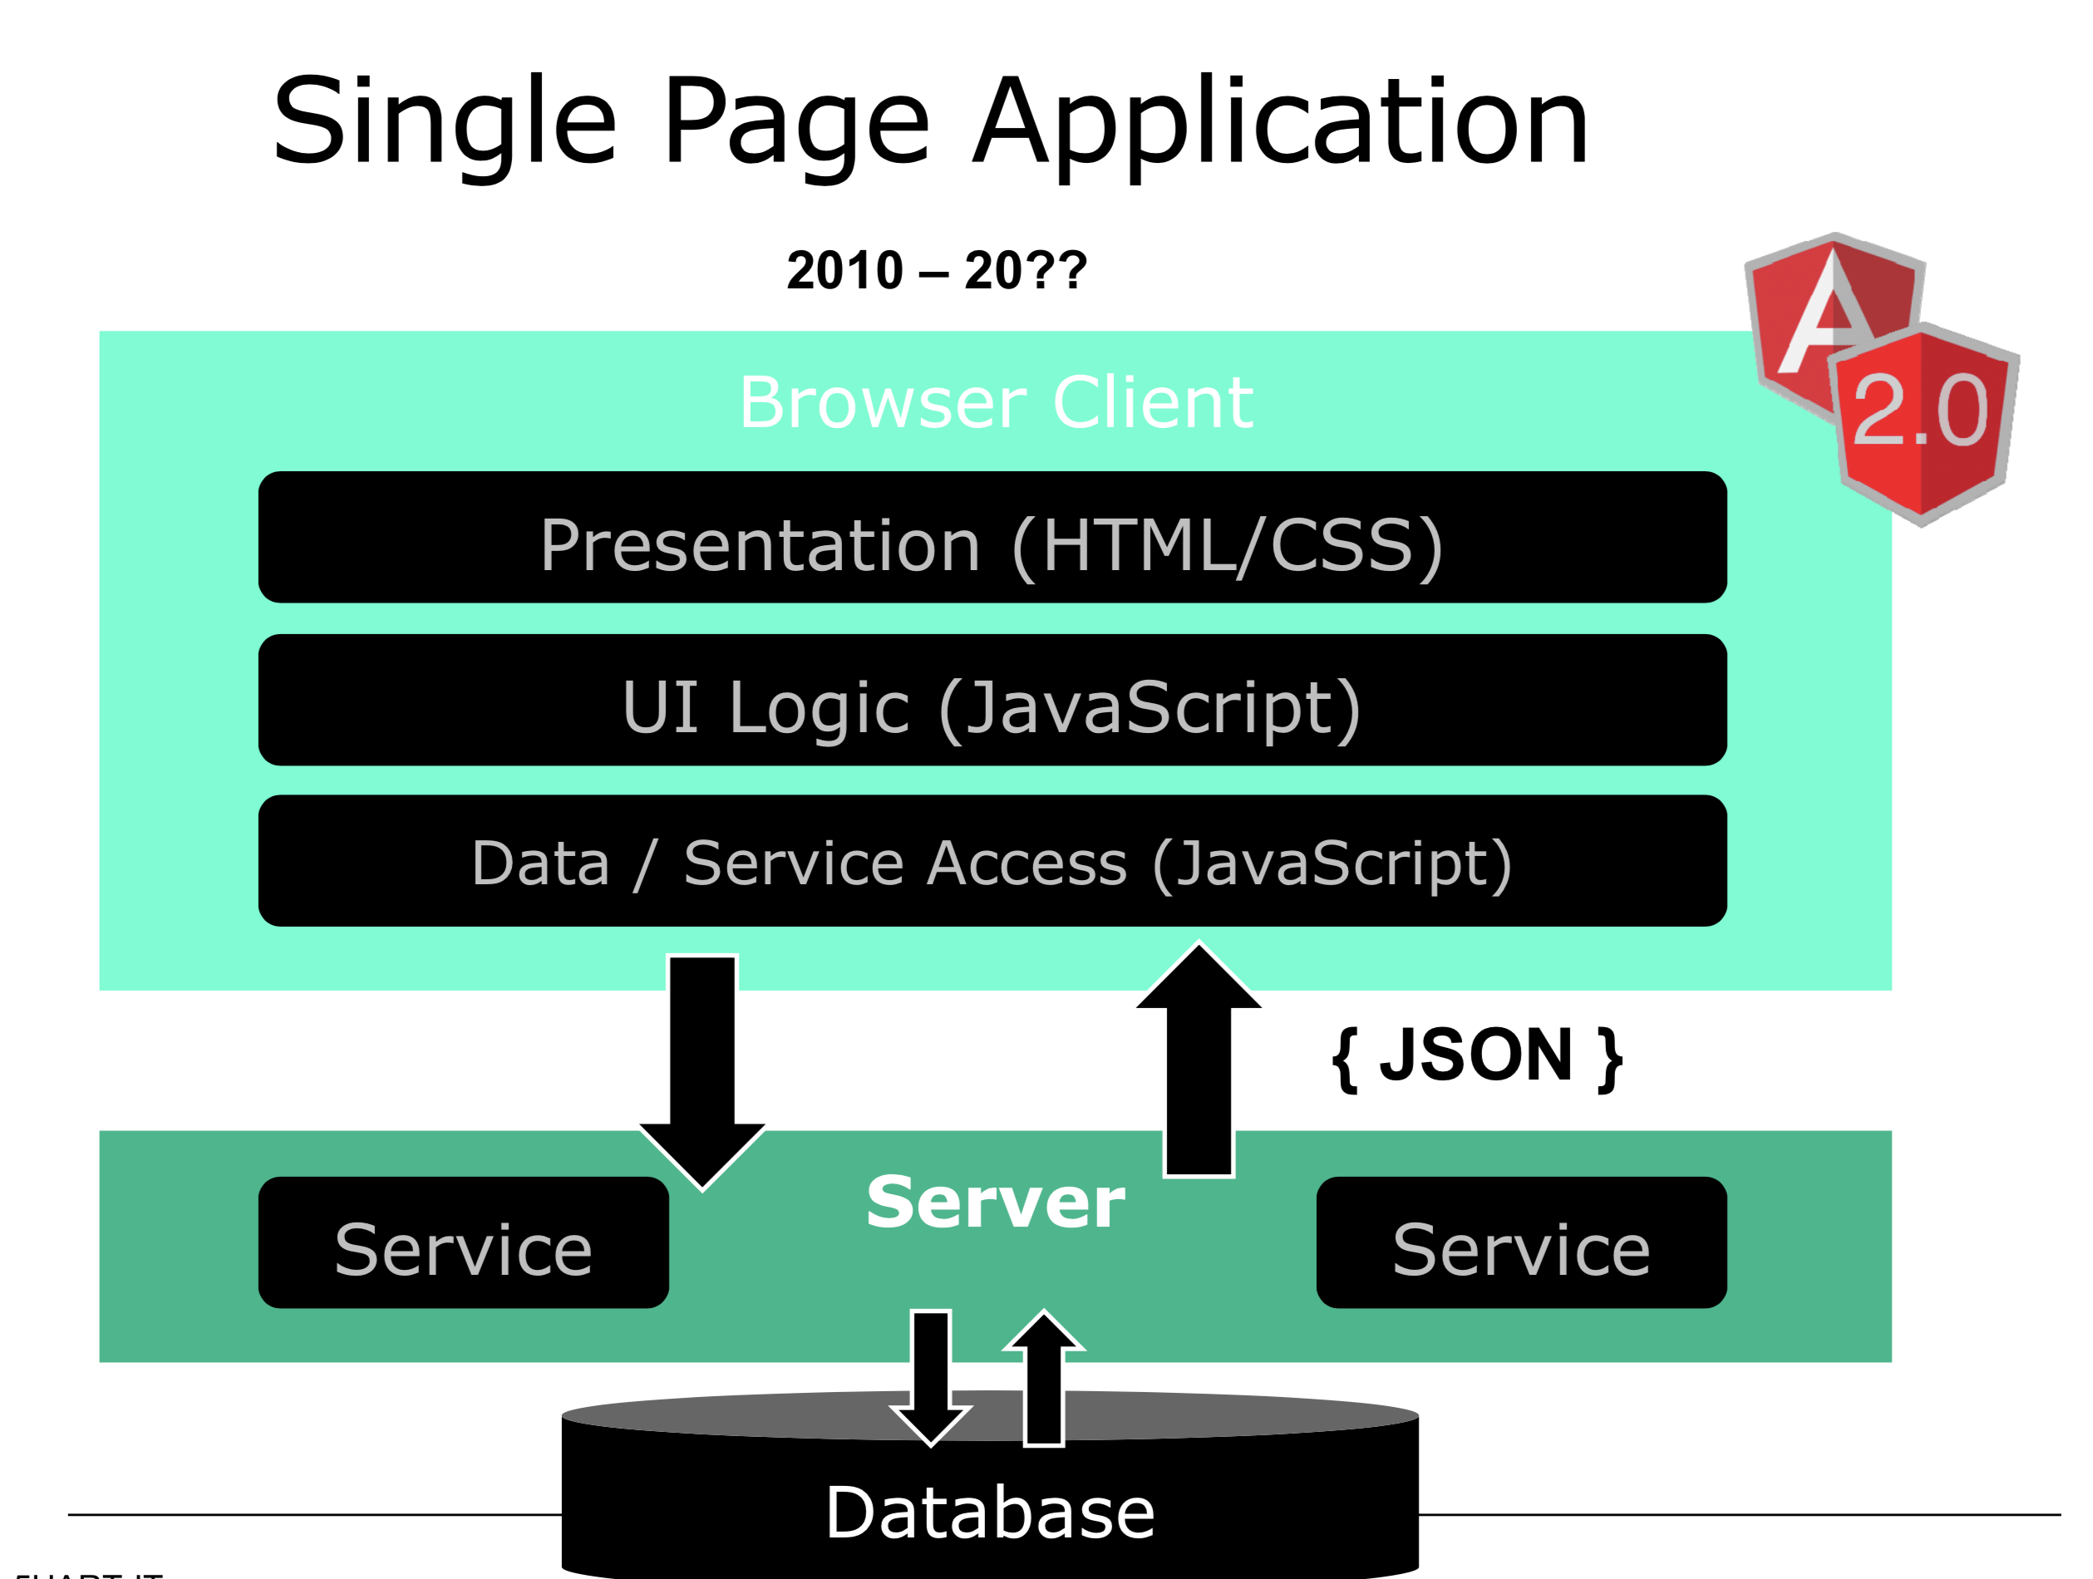

Slide 10




Slide 11
Angular characteristics
Community Speed
Simplicity & Consistency
Notes:
Snelheid rendering & performance

Slide 12
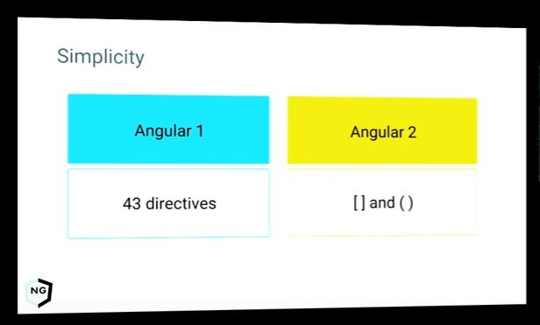
Consistency & simplicity
Consistente naamgeving & architectuur Consistente data binding

Slide 13
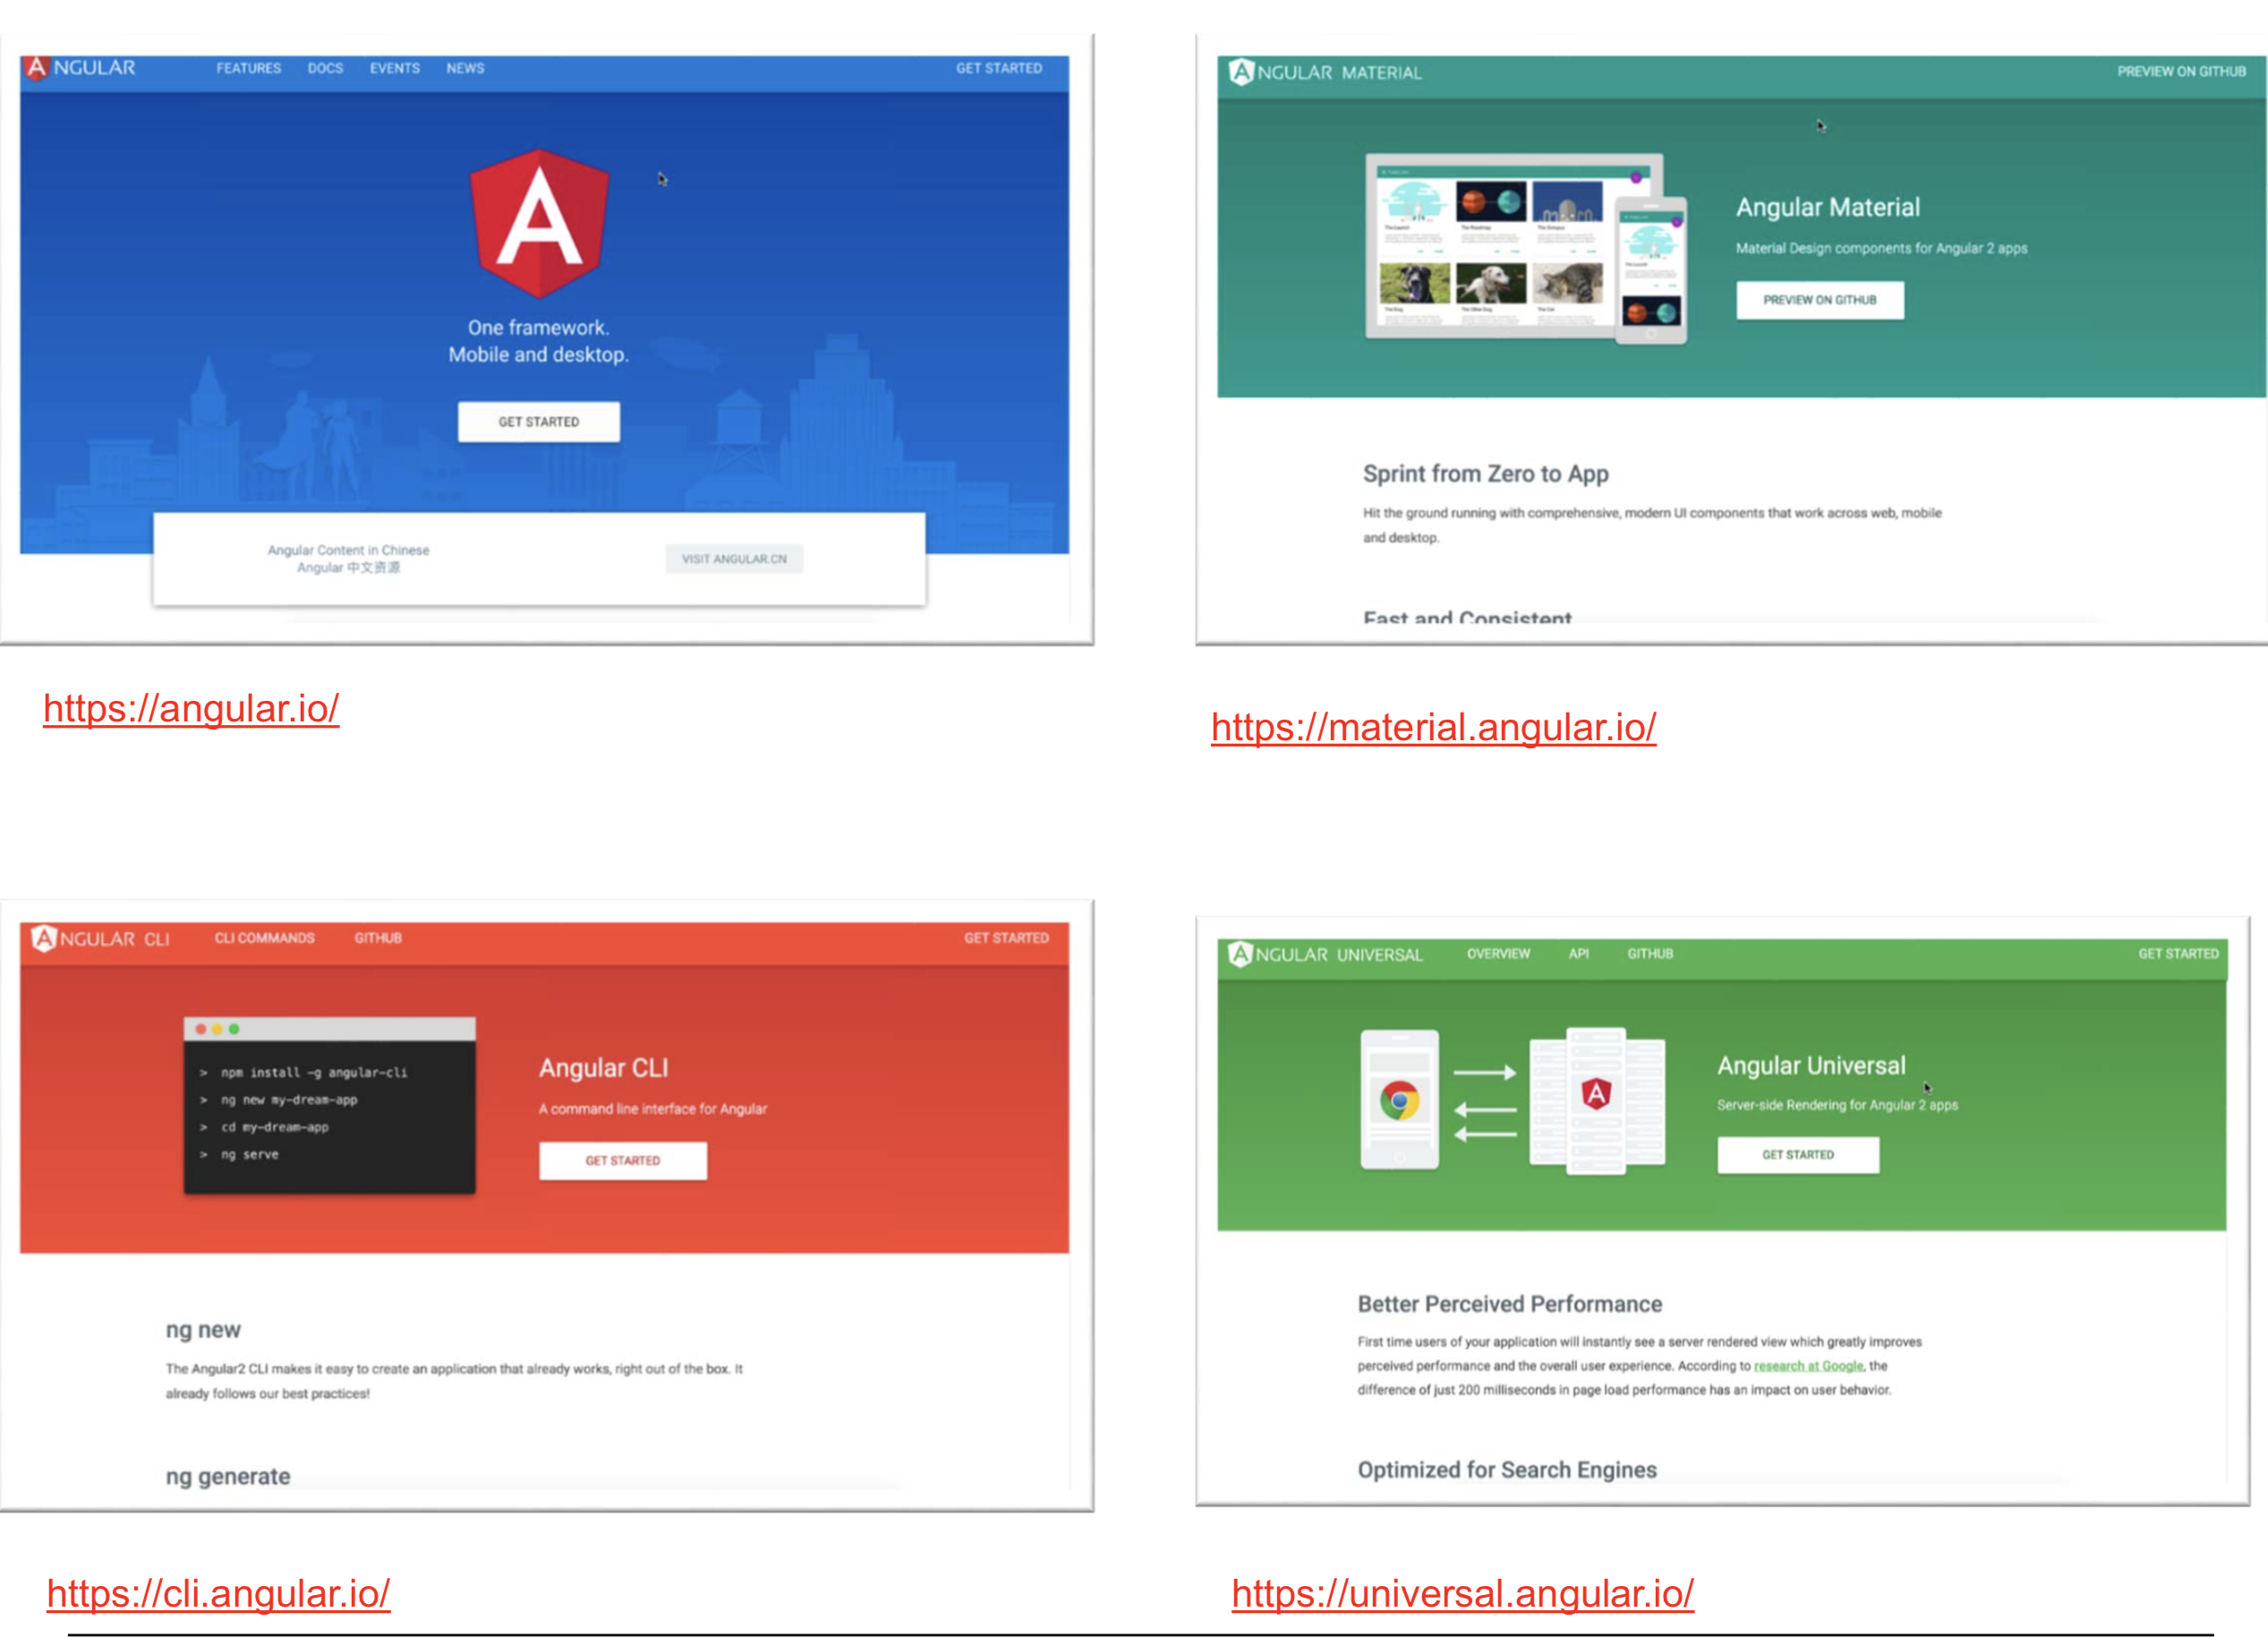

Slide 14
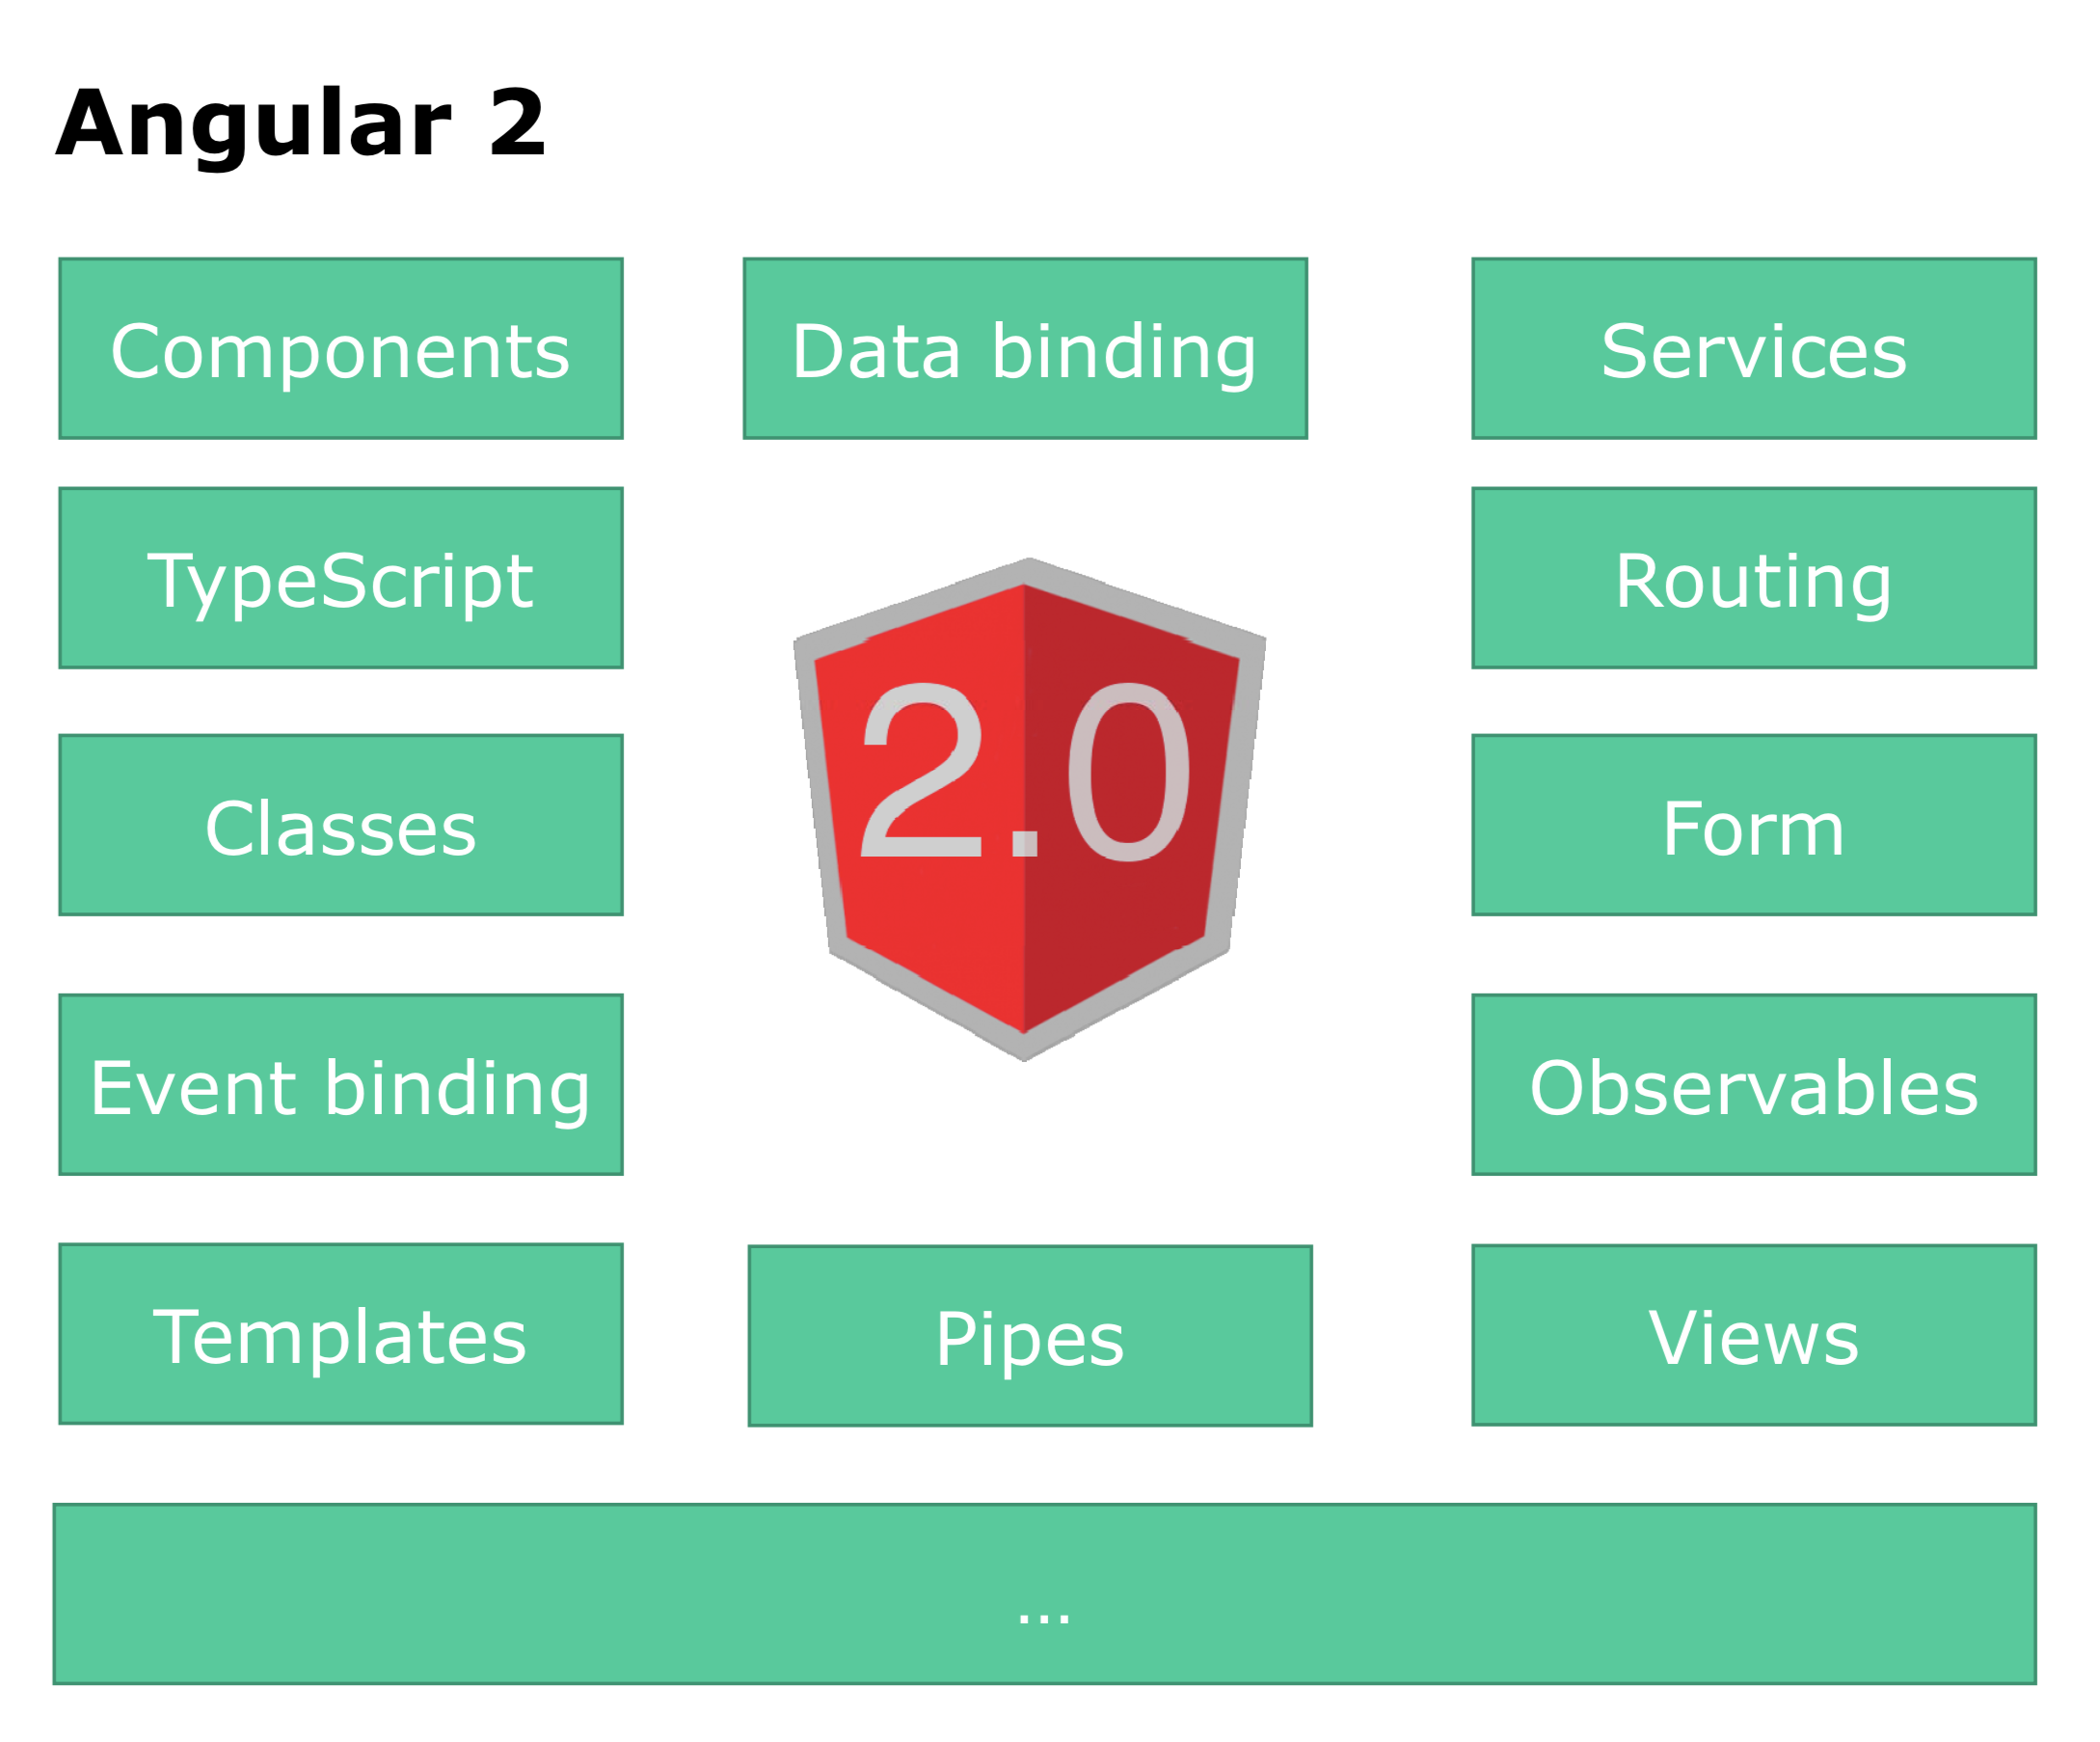

Slide 15
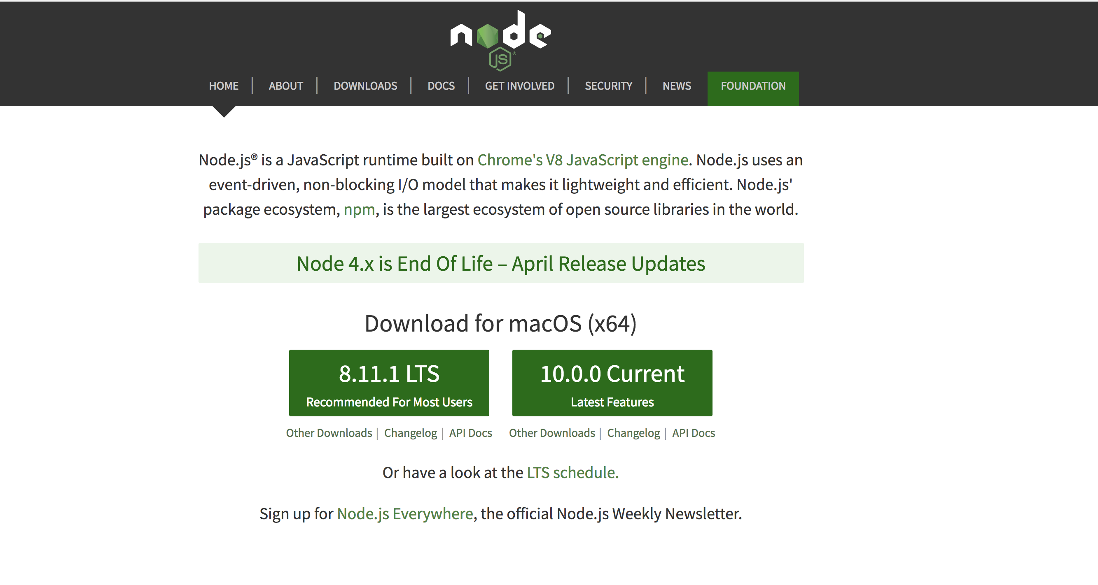
Install Node

Slide 16
IDE

Slide 17
Angular
TypeScript
Component based
DI
Efficient development
Notes:
TypeScript en Angular 2 gaan hand in hand. TypeScript is een typed superset van JavaScript
Component based → Is herbruikbare logica die je toevoegt aan je html-pagina.
Performance beter! → Betere/efficientere structuur: Angular 2 Apps zijn opgebouwd volgens een boomstructuur.
Geen $Scope → Geen gezamenlijk gebruik van de Scope. Componenten zijn niet meer gekoppeld aan elkaar middels $Scope.
DI – Wordt gebruik gemaakt van interfaces (niet van concrete implementaties)
IDE → refactoring + autocompletion + type error op compilatie en runtime nivo
http://www.technofattie.com/2014/03/21/five-guidelines-for-avoiding-scope-soup-in-angular.html
http://busypeoples.github.io/post/thinking-in-components-angular-js/
- Gezamenlijk gebruik van $scope door meerdere controllers → controller kunnen niet afzonderlijk getest worden.
Problemen met scope in controller:
Niet makkelijk te testen
Controller is gekoppeld aan $scope
Controller niet herbruikbaar
Controller moeilijk te onderhouden
Gezamenlijk gebruik van $scope door meerdere controllers
- Scope kan je niet migreren

Slide 18
TypeScript

Slide 19
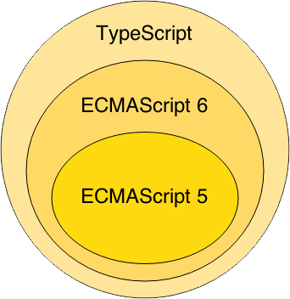
TypeScript
Notes:
Waarom TypeScript?
TypeScript is superset of ES6 en ES5.
ES = Standaard specificatie van JavaScript
ES6 = de nieuwste specificatie van Javascript, maar wordt nog niet ondersteund in alle browsers.
ES5 is de huidige standaard voor javascript en wordt ondersteund in de browsers.
TypeScript wordt vertaald naar ES5 (Middels een Transpiler).
TypeScript = Annotaties + Types + Interfaces + ES6
-----------------
TypeScript is van Microsoft.
Javascript is geschreven conform ES5

Slide 20


TypeScript = Annotaties + Types + Interfaces + ES6

Slide 21
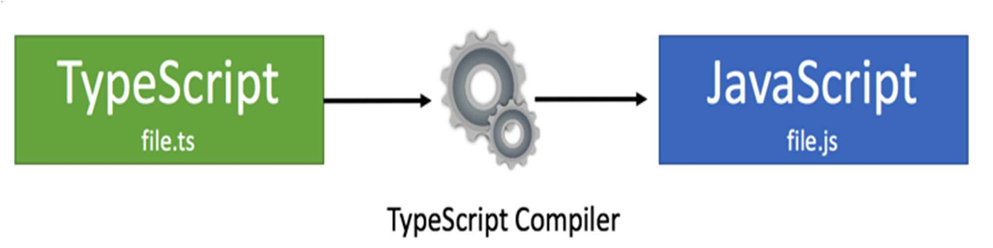
TypeScript Compilation
Zowel TypeScript als ES 6: compilatie nodig,
Huidige generatie browsers begrijpt ES6 en TypeScript niet.

Slide 22
TypeScript Class
class BookListComponent {
books: String[];
constructor() {
this.books =[‘book1’, ‘book2’]
}
}
Notes:
Example of a TypeScript class !!!
This refers to the class.

Slide 23
Components

Slide 24
Component based A component adds logic to DOM elements Angular app consist of a treestructuur of components
main.ts
AppModule
AppComponent
app.component.html
BookSearchComponent
DashBoardComponent
BooksComponent
BookDetalsComponent
Notes:
Angular is a tree of components, because it has the same structure as your html-structure !!!
Index.html is the parent template of AppComponent ect…
AppComponent is the parent of BookComponent and …
main.ts

Slide 25


Slide 26
Component based
SideBarComponent
AppModule
Module
AppComponent
BookSearchComponent
DashboardComponent
Notes:
Angular apps are composed of modules.
Modules exports classes, function, values — that other modules import.

Slide 27
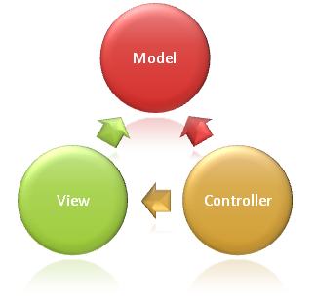
Syntax Component
import {Component} from ’@angular/core';
@Component({
selector: ‘book-list'
templateUrl: ‘booklist.template.html'
})
export class BookListComponent {
books: string[];
constructor() {
this.books =[‘book1’, ‘book2’]
}
}
Notes:
Structuur
This class is written in Typescript!
How to convert this class in a Component:
- You import the Typescript libraries from Angular ---> a Component is imported here
- You can now convert the class in a Component with the @Component annotation
- templateUrl - the address of this component's template
How does this work in action
With the selector you can instantiate and call the component
With the CSS selector you can tell Angular to create an instance of this component where it finds a <grocery-list> tag in parent HTML.
You export the Component class so that you can import and use it in the rest of your application.

Slide 28
Selector in index.html
….
<book-list></book-list>
….

Slide 29
Syntax template booklist.template.html
<p>Booklist: </p>
<ul>
<li *ng-for = “let book of books">
{{book}}
</li>
</ul>
Notes:
https://angular.io/docs/ts/latest/guide/template-syntax.html#!#star-template
*ng-for – Why?
The STAR Turns the li element and its contents into a template, and uses that template to instantiate a view for each item in list.

Slide 30
Module
SideBarComponent
AppModule
Module
AppComponent
BookSearchComponent
DashboardComponent
Notes:
Angular apps are composed of modules.
Modules exports classes, function, values — that other modules import.

Slide 31
AppModule
import {NgModule} from ‘@angular/core';
import {BrowserModule} from ‘@angular/platform-browser';
import {AppComponent} from ‘./app.component';
import {BookSearchComponent} from ‘../book-search/book-search.component';
import {DashboardComponent} from ‘../dashboard/dashboard.component';
@NgModule({
imports: [BrowserModule], // inject build-in modules
declarations: [AppComponent , BookSearchComponent, DashboardComponent], // inject your own components
bootstrap: [AppComponent] // main component you need to bootstrap
})
export class AppModule { }
Notes:
AppModule is the main entrypoint of your application = root module
@NgModule: Use @NgModule to Manage Dependencies in your Angular 2 Apps
Since we declared the BookListComponent in our root module, we can now use this BookListComponent anywhere in our application without needing to declare or import it again. In essence, the @NgModule handles dependency injection for us, so any component we declare will have the inherent knowledge of our other dependencies. We are not limited to declaring only components here, we could additionally write a directive or service, and declare use it the exact same way.
Imports: for importing build-in modules example BrowserModule for using: *ng-for
Declarations: for injecting your own components
Bootstrap: you need to bootstrap your main component
An‘umbrella’component(akaModule),holding all the dependencies that the Injector needs
• TypeScript annotation:@ngModule({...})
Inject other components
Inject Services/Providers
Bootstrap the Rootcomponent

Slide 32
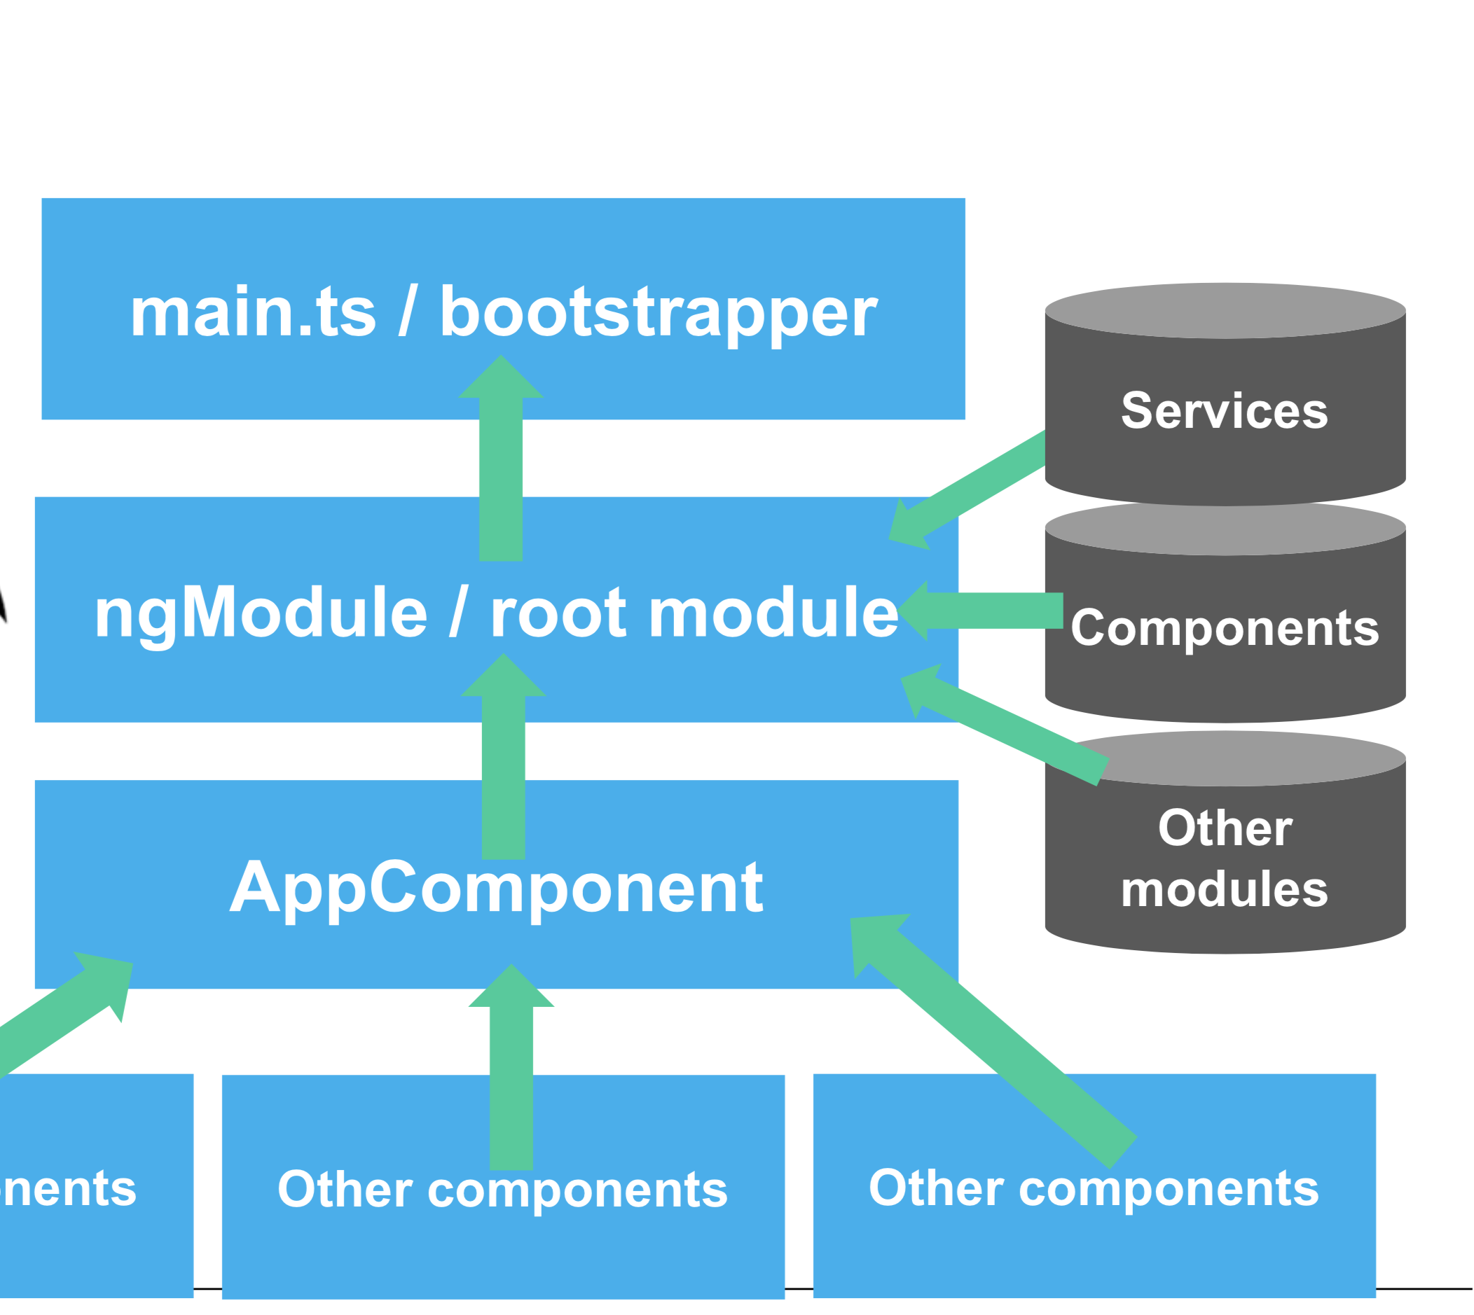

Slide 33
Angular CLI
Snel nieuwe projecten instellen via de command line

Slide 34
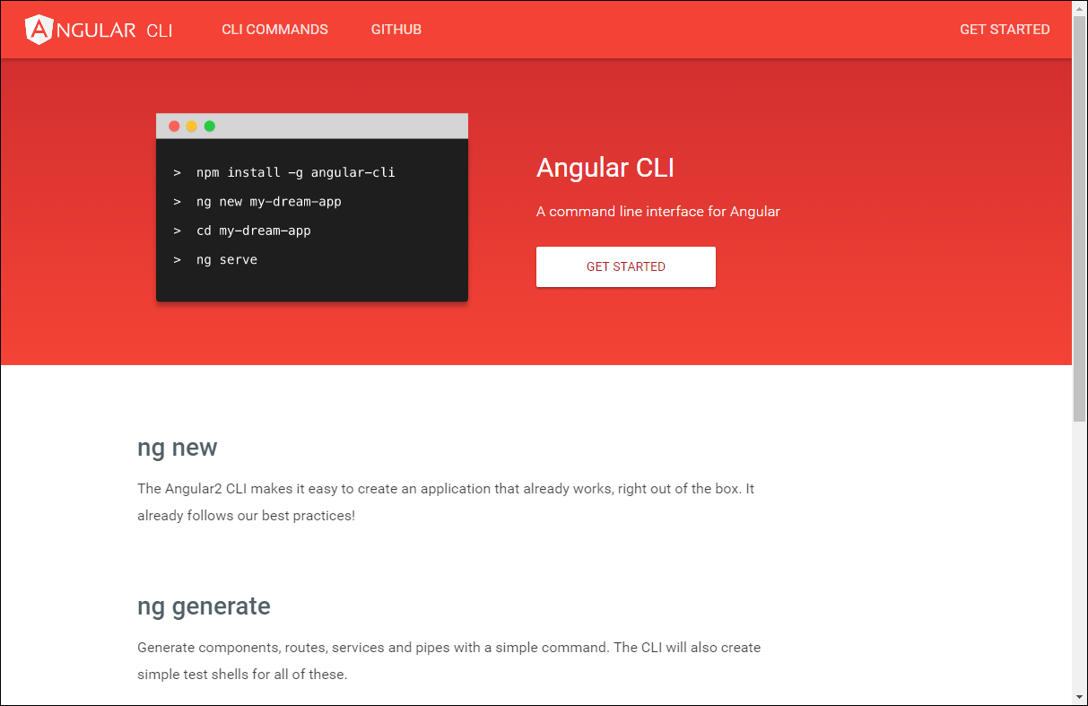

Slide 35
Install/Upgrade Angular CLI to 7
Install node (check: node -v)
Check your current version of Angular CLI:
ng –version
Uninstall the angular-cli package globally:
[sudo] npm uninstall -g angular-cli // For Mac
npm uninstall -g angular-cli // For Windows

Slide 36
Install/Upgrade Angular CLI to 7
Clear the cache
[sudo] npm cache verify
npm version is < 5. (npm --version)
npm cache clean
Install the Angular CLI
[sudo] npm install -g @angular/cli@latest
Notes:
If your version is still old, then try the following command:
-> ng update @angular/cli
check:
ng --version

Slide 37
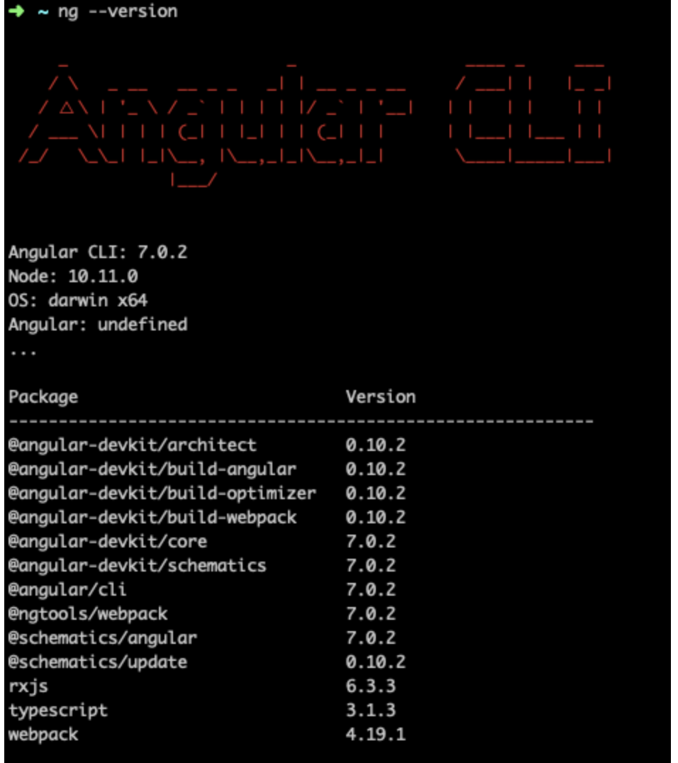
Check your Angular CLI version

Slide 38
Clear the cache
After updating both the global and local package, clear the cache to avoid errors:
npm cache verify (recommended)
npm cache clean (for older npm versions)

Slide 39
Update Angular Packages
ng update @angular/core
ng update rxjs

Slide 40
Scaffolding - Angular CLI
Notes:
Projecten, componenten, routes en meer definiëren vanaf de command line (CLI)

Slide 41
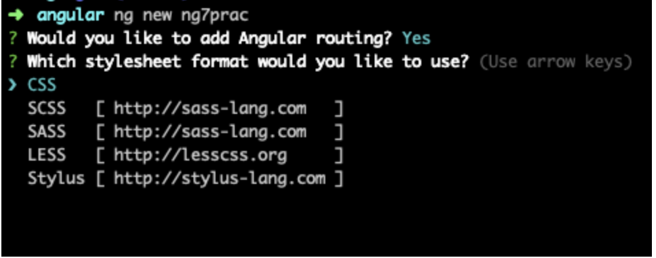
Generating an Angular project
ng new my-project
Notes:
The ng new command creates an Angular workspace folder and generates a new app skeleton.

Slide 42
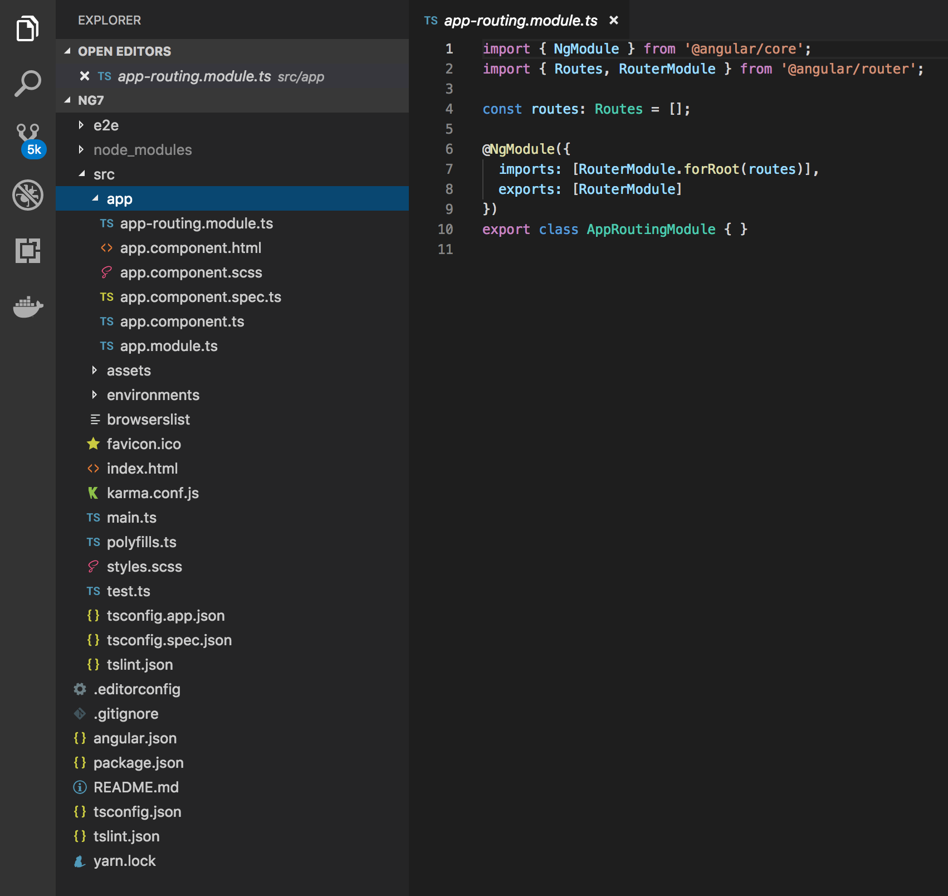
Notes:
A newly generated app contains the source files for a root module, with a root component and template. Each app has a src folder that contains the logic, data, and assets.

Slide 43
Generating and serving an Angular project
ng new my-project
cd my-project
ng serve
In your browser, open http://localhost:4200/
Notes:
The ng new command creates an Angular workspace folder and generates a new app skeleton.
ng serve → When you use the ng serve command to build an app and serve it locally, the server automatically rebuilds the app and reloads the page when you change any of the source files.

Slide 44
ng generate

Slide 45
ng generate
Use the ng generate command to:
generate new components
generate new services
Notes:
https://scotch.io/tutorials/use-the-angular-cli-for-faster-angular-2-projects

Slide 46
DEMO
Generate a new component in Hello World

Slide 47
Exercise
Go to folder: “Exercises Angular7”
and start the first exercise in: Oefeningen Angular.docx

Slide 48
ng generate exercise
https://medium.com/all-is-web/angular-5-creating-new-component-c6c5236f8024

